Slide 1
EENSULATE project presentation
Event name
Location, date
Presenter name
Company

Slide 2
EENSULATE PROJECT
Focus on developing solution for envelope insulation to bring existing curtain wall buildings to “nearly zero energy” standards.
6,6 million budget
42 months
14 partners
8 work packages

Slide 3
INTRODUCTION
Thermal and acoustic insulation
Affortable
cost
Improved indoor environment
Light transmittance
Environmental friendliness
Existing buildings, including historical ones, are responsible
for up to 60% of energy losses through the envelope.
Higher fire resistance

Slide 4
OBJECTIVES
Develop a product that will meet the market demand for affordable and prefabricated façade retrofitting system with limited weight and thickness.

Slide 5
CONCEPT
EENSULATE Basic modules
Thermal and acoustic insulation will be provided by the novel VIG and “smart foam” in the spandrel combined with state of the art low-E coated glass.
EENSULATE Premium modules
Multi-functionality by integrating novel thermos-chromic coated glass with additional self-cleaning and anti-fogging properties.

Slide 6
KEY PRODUCTS
EENSULATE FOAM
Highly insulating spray foam for the cost-effective manufacturing and insulation of the opaque components of curtain walls.
EENSULATE GLASS
A lightweight and thin double pane vacuum glass for the high insulation of the transparent component of curtain walls.

Slide 7
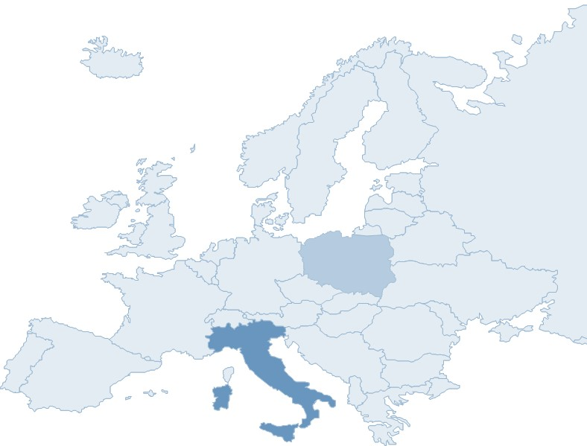



DEMOSITE
The focus will be placed on the thermo-acoustic behaviour of demo buildings and indoor comfort. Different parameters will be monitored, such as internal and external wall condition, indoor temperature and humidity, acoustic performance etc.
School Building
(Dzierżoniów, Poland )
City Museum
(Dzierżoniów, Poland )
Public Library San Giovanni
(Pesaro, Italy)

Slide 8






PARTNERS

Slide 9
CONTACT INFO
For further project information please contact:
Daniela RECCARDO
Project Coordinator
D'Appolonia S. p. A.
+39 010 3628148
daniela.reccardo@dappolonia.it
www.eensulate.eu
Follow project latest news on social network profiles:

Slide 10
THANK YOU FOR ATTENTION!
Presenter name
Company
Email

